Slide 2
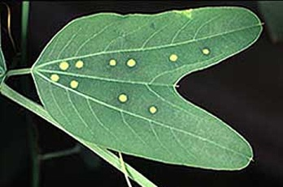
Passionflower Vine

Slide 3
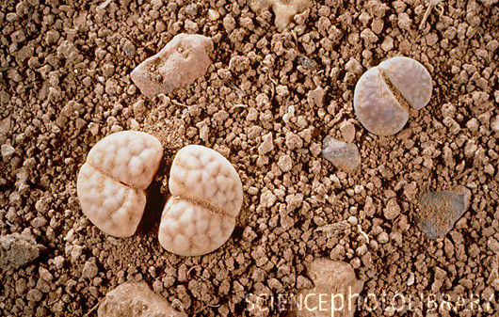
Stone Plant

Slide 4
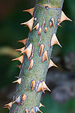
Rose Bush

Slide 5
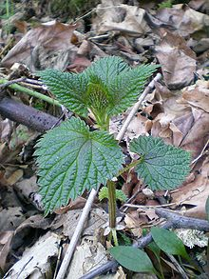
Nettle Plant

Slide 6
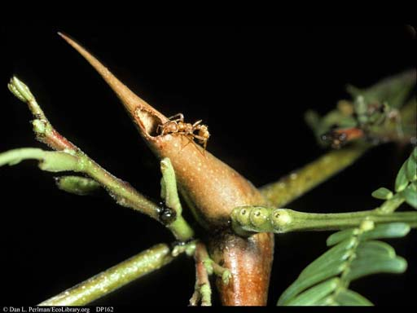
Bulls-Horn Acacia

Slide 7
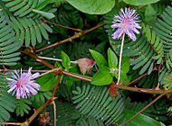
Mimosa
http://en.wikipedia.org/wiki/Mimosa_pudica

Slide 8
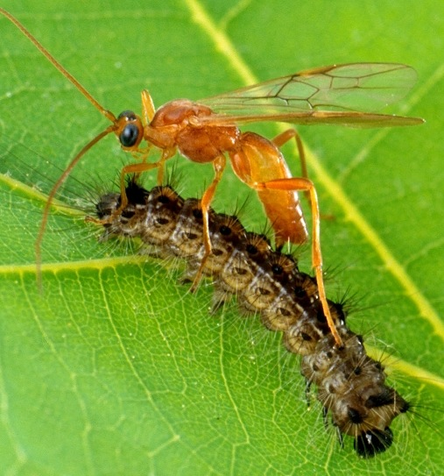
Corn & Wasp

